Slide 1
Python’s Standard Library
Josh Lawrence
Dennis Tran
Ramesh S

Slide 2
Operating System Interface
The os module provides dozens of functions for interacting with the operating system:
import os #imports the os interface module
dir(os) #returns a list of module’s functions
help(os) #returns an extensive manual page
Some os module functions:
os.getcwd() # get current working directory
os.chdir('/usr/cs265') # change current working directory
os.system('mkdir lab1') # perform a mkdir in the system shell

Slide 3
Shutil module
Use for daily file/directory management tasks
import shutil
#copies data.db to archive.db
shutil.copyfile('data.db', 'archive.db')
#move(source, destination)
shutil.move('/build/executables', 'installdir')

Slide 4
File Wildcards
The glob module provides a function for making file lists from directory wildcard searches
import glob
glob.glob('*.py')
['primes.py', 'random.py', 'quote.py']

Slide 5
Command Line Arguments
Command line arguments are stored in the sys module’s argv attribute as a list:
If at command line python demo.py one two three is executed:
import sys
print sys.argv
['demo.py', 'one', 'two', 'three']

Slide 6
Error Output Redirection and Program Termination
The sys module also has attributes for stdin, stdout, and stderr. The latter is useful for emitting warnings and error messages to make them visible even when stdout has been redirected:
sys.stderr.write('Warning, log file not found, starting a new one\n')
Warning, log file not found, starting a new one

Slide 7
String Pattern Matching
The re module provides regular expression tools for advanced string processing.
r - Python’s raw string notation for regular expression patterns
re.findall(r'\bf[a-z]*', 'which foot or hand fell fastest')
['foot', 'fell', 'fastest']

Slide 8
Mathematics
The math module gives access to the underlying C library functions for floating point math:
import math
math.cos(math.pi / 4.0)
0.70710678118654757
math.log(1024, 2)
10.0

Slide 9
Random
The random module provides tools for making random selections:
import random
random.choice(['apple', 'pear', 'banana'])
'apple‘
# sampling without replacement
random.sample(xrange(100), 10)
[30, 83, 16, 4, 8, 81, 41, 50, 18, 33]
# random float
random.random()
0.17970987693706186
# random integer chosen from range(6)
random.randrange(6)
4

Slide 10
Internet Access
There are a number of modules for accessing the internet and processing internet protocols. Two of the simplest are urllib2 for retrieving data from urls and smtplib for sending mail:
import urllib2
for line in urllib2.urlopen('http://tycho.usno.navy.mil/cgi-bin/timer.pl'):
if 'EST' in line or 'EDT' in line: # look for Eastern Time
print line
<BR>Nov. 25, 09:43:32 PM EST
import smtplib
server = smtplib.SMTP('localhost')
server.sendmail('soothsayer@example.org', 'jcaesar@example.org', """To: jcaesar@example.org ,From: soothsayer@example.org ,Beware the Ides of March. """)
server.quit()

Slide 11
Dates and Times
The datetime module supplies classes for manipulating dates and times in both simple and complex ways. The module also supports objects that are timezone aware.
# dates are easily constructed and formatted
from datetime import date
now = date.today()
now
datetime.date(2003, 12, 2)
now.strftime("%m-%d-%y. %d %b %Y is a %A on the %d day of %B.")
'12-02-03. 02 Dec 2003 is a Tuesday on the 02 day of December.'
# dates support calendar arithmetic
birthday = date(1964, 7, 31)
age = now – birthday
age.days
14368

Slide 12
Data Compression
Common data archiving and compression formats are directly supported by modules including: zlib, gzip, bz2, zipfile and tarfile.
import zlib
s = 'witch which has which witches wrist watch‘
len(s)
41
t = zlib.compress(s)
len(t)
37
zlib.decompress(t)
'witch which has which witches wrist watch‘
zlib.crc32(s)
226805979

Slide 13
Performance Measurement
from timeit import Timer
Timer('t=a; a=b; b=t', 'a=1; b=2').timeit()
0.57535828626024577
Timer('a,b = b,a', 'a=1; b=2').timeit()
0.54962537085770791

Slide 14
Quality Control
The doctest module provides a tool for scanning a module and validating tests embedded in a program’s docstrings.
def average(values):
"""Computes the arithmetic mean of a list of numbers.
>>> print average([20, 30, 70])
40.0 """
return sum(values, 0.0) / len(values)
import doctest
# automatically validate the embedded tests
doctest.testmod()

Slide 15
Quality Control
The unittest module allows a more comprehensive set of tests to be maintained in a separate file:
import unittest
class TestStatisticalFunctions(unittest.TestCase):
def test_average(self):
self.assertEqual(average([20, 30, 70]), 40.0) self.assertEqual(round(average([1, 5, 7]), 1), 4.3) self.assertRaises(ZeroDivisionError, average, []) self.assertRaises(TypeError, average, 20, 30, 70)
# Calling from the command line invokes all tests
unittest.main()

Slide 16

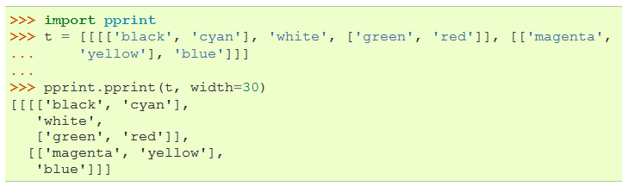
Output Formatting
The repr module provides a version of repr() customized for abbreviated displays of large or deeply nested containers
The pprint module offers more sophisticated control over printing objects in a way readable by the interpreter
  “pretty printer” adds appropriate line breaks and indentation when the result is more than one line

Slide 17
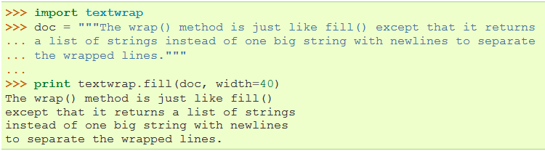
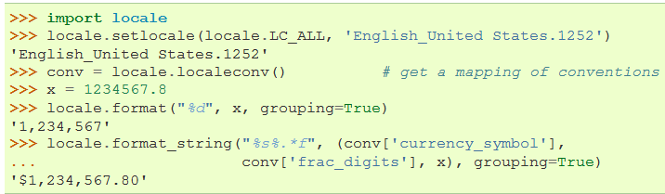
Output formatting
Can use the textwrap module to format paragraphs of text to fit a given screen width
The locale module access a database of cultural specific data formats
  Allows programmers to deal with certain cultural issues in an application w/out knowing all the specifics of where the SW is executed

Slide 18

Templating
The string module includes a Template class with a simplified syntax suitable for editing by end users
  Format uses placeholder names formed by $
    substitute() method performs template substitution, returning a new string
    “$$” creates a single escaped $
    Surround placeholder with “{ }” to follow it with more alphanumeric characters

Slide 19
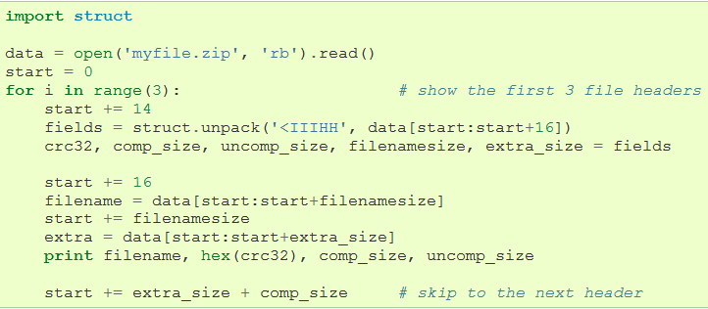
Working with Binary Data Record Layouts
The struct module provides pack() and unpack() functions for working with variable length binary record formats
  Example below shows how to loop through header info in a ZIP file w/out using the zipfile module
  Pack codes “H” and “I” represent two and four byte unsigned integers
  “<“ indicates pack codes are standard size and in little-endian byte order

Slide 20
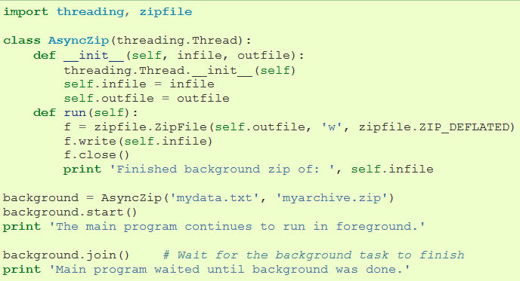
Multi-threading
Use the threading module to run tasks in the background while the main program runs
  After creating a thread object, call the start() method to invoke the run() method in a separate thread of control
  join() method waits until a thread terminates

Slide 21
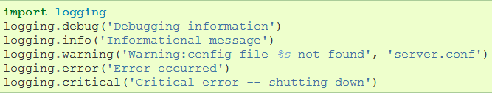

Logging
The logging module offers a full featured and flexible logging system for applications
  Log messages usually sent to a file or sys.stderr
Example:
  Produces the following output:
Other output options include routing messages through email, datagrams, sockets, or an HTTP server

Slide 22
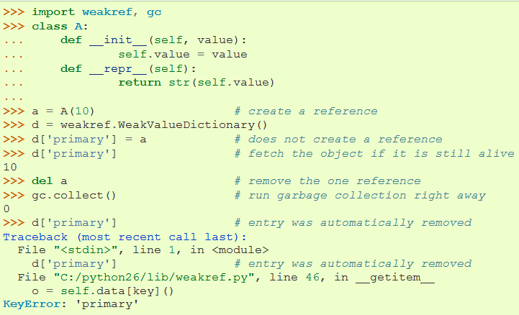
Weak References
The weakref module provides tools to track objects without creating references
  When an object is no longer needed, it is automatically removed from the weakref table and a callback is triggered for weakref objects
    WeakKeyDictionary is a mapping class that references keys weakly
    Entries in dictionary are destroyed when there is no longer a strong reference to the key

Slide 23
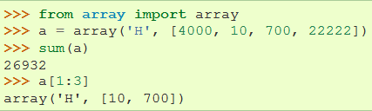
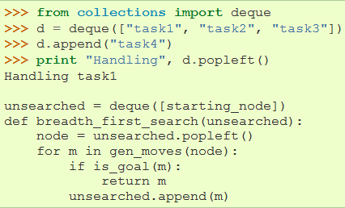
Tools for Working with Lists
The array module provides an array() object that stores data of a single type more compactly
  Typecode “H” represents two byte unsigned binary numbers
The collections module provides a deque() object with fast appends and O(1) pops from either side; good for implementing queues and breadth first tree searches

Slide 24
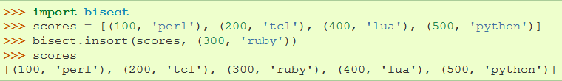
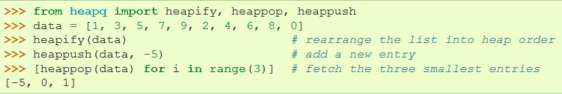
Tools for Working with Lists
The bisect module contains functions for manipulating sorted lists
  Implements bisection algorithm
The heapq module provides functions for implementing heaps based on regular lists
  Implements the heap queue algorithm
  Smallest valued entry always kept at position 0

Slide 25
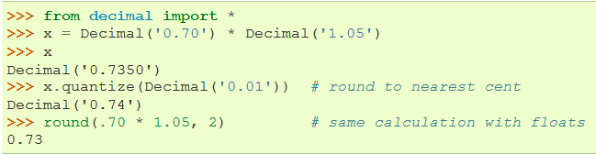
Decimal Floating Point Arithmetic
The decimal module can be used for decimal floating point arithmetic
Useful for:
  Financial applications that require exact decimal representation
  Control over precision
  Control over rounding to meet legal or regulatory requirements
  Tracking of significant figures
  Applications where the results should match hand calculations
Difference of results between decimal floating point and binary floating point:

Slide 26
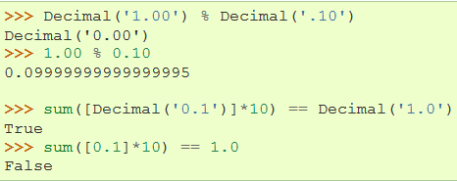

Decimal Floating Point Arithmetic
Exact representation enables the Decimal class to perform modulo calculations and equality tests where binary floating point would fail:
decimal module also provides arithmetic with as much precision as needed
  Using getcontext().prec method to set # of decimal places:

Slide 27
References
Python v2.7.1 documentation
  “11. Brief Tour of the Standard Library Part II”
    http://docs.python.org/tutorial/stdlib2.html
  “The Python Standard Library”
    http://docs.python.org/library/

